Slide 1
Order & Restaurant Analysis Using Power BI
Objective:
Developing an interactive Power BI dashboard to evaluate restaurant performance, regional sales, and customer behavior.
Tools: MySQL Power Query, DAX, and Power BI Desktop.
Presented by: N Elangovan
BMAI-C-WD-E-B16

Slide 2
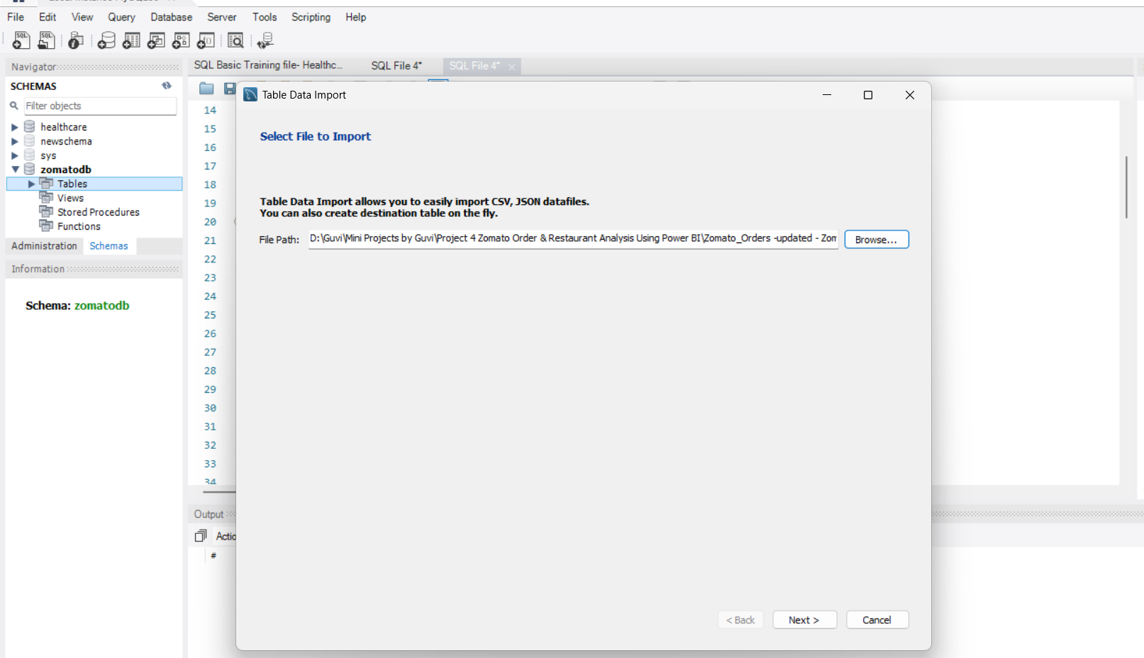
Task 1: Data Preparation & Cleaning (MySQL)
Objective: To clean and transform the raw Zomato dataset into a usable format.
Steps Taken:
    Imported the dataset into Power BI Desktop.
Used Power Query Editor to remove duplicates and handle null values.
Formatted column types (e.g., ensuring order_date is a Date type and Total Sales is a Decimal number).
Insights: Clean data ensures that the final dashboard visuals are 100% accurate and free from errors.
Recommendations: Always maintain a 'Backup' of the raw data before starting the cleaning process to prevent accidental data loss.

Slide 3
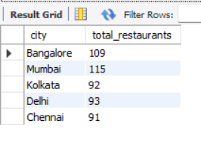
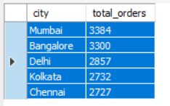
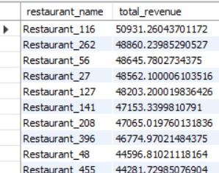
Task 2: Data Modeling & Relationship Building
Objective: To establish connections between different data tables for better analysis.
Steps Taken:
Defined relationships between the sales data and dimension tables (like City or Restaurants).
Ensured One-to-Many relationships where applicable (e.g., one city can have many orders).
Insights: Strong data modeling allows filters (Slicers) to work across the entire dashboard simultaneously.
Recommendations: Use a Star Schema model to optimize the performance of the dashboard as the dataset grows.

Slide 4
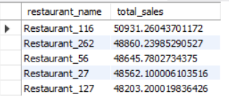
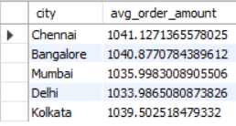
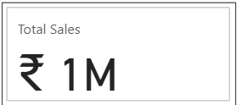
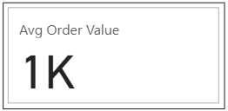
Task 3: Creating DAX Measures for KPIs
Objective: To calculate key business metrics using Data Analysis Expressions (DAX).
Steps Taken:
Total Sales: Created a measure Total Sales = SUM(Zomato_Final_Data[total_cost]).
Average Order Value (AOV): Calculated as Avg Order Value = AVERAGE(Zomato_Final_Data[total_cost]).
Insights: These measures provide the high-level numbers (₹ 1M Sales, ₹ 1K AOV) that drive the entire business strategy.
Recommendations: Use these DAX measures in KPI Cards at the top of the dashboard for immediate visibility.

Slide 5
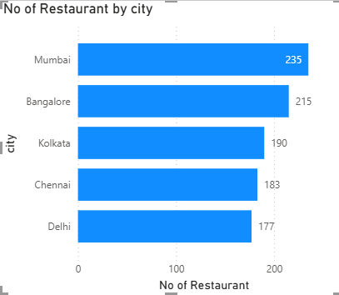
Task 4 – Top 5 Performing Restaurants (Bar Chart)
Insights:
Mumbai leads the market with the highest number of partner restaurants (235), followed by Bangalore (215). Delhi has the lowest partner count among the major cities at 177.
Recommendations:
Focus on aggressive restaurant onboarding in Delhi to bridge the supply gap and increase market share in the capital city.

Slide 6
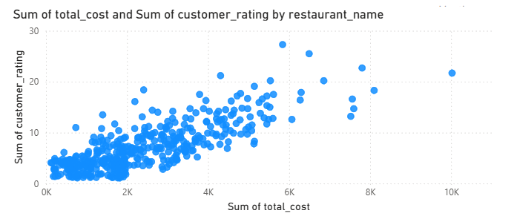
Task 5: Correlation of Rating vs. Cost (Scatter Plot)
Insights:
Insight: There is a clear concentration of restaurants in the low-to-mid cost range (₹0 - ₹4K) with varied ratings. High-cost restaurants (₹8K+) generally maintain a consistent rating above 3.5, indicating better service quality in premium segments.
Recommendations:
Implement a "Quality Support Program" for low-cost restaurants with ratings below 3.0 to help them improve service without significantly increasing prices.

Slide 7
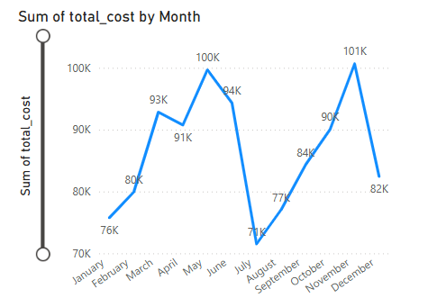
Task 6: Seasonal Sales Performance (Line Chart)
Insights:
Revenue is highly seasonal, peaking in June (₹100K) and November (₹101K). A significant "slump" occurs in August, where sales drop to ₹71K.
Recommendations:
Launch "August Monsoon Festivals" or exclusive discount weeks during the August slump to stabilize the yearly revenue curve.

Slide 8
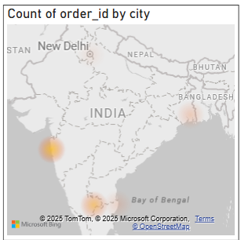
Task 7: Geographic Order Density (Heat Map)
Insights:
The Heat Map confirms that the South and West regions (Bangalore & Mumbai) are the primary revenue engines. Northern regions show scattered demand with lower density.
Recommendations:
Allocate higher marketing budgets for localized ads in Mumbai and Bangalore to capitalize on the high order intent already present there.

Slide 9
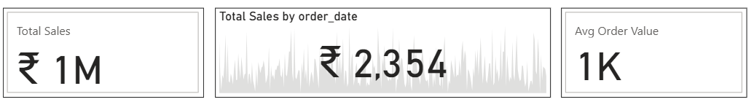
Task 8 – Key Performance Indicators (KPIs)
Insights:
Revenue Milestone: The platform has achieved a total sales volume of ₹1M, indicating a strong market presence.
Stability of AOV: The Average Order Value (AOV) stands at ₹1K, suggesting that the typical customer prefers mid-range dining options.
Trend Awareness: The sparkline on the KPI card shows significant daily fluctuations, identifying specific peak days for sales.
Recommendations:
Upselling Strategy: Implement a "Frequently Bought Together" feature to increase the current AOV from ₹1K to ₹1.2K.
Growth Target: Aim for a 15% increase in Total Sales by focusing on high-performing days identified in the trend line.

Slide 10
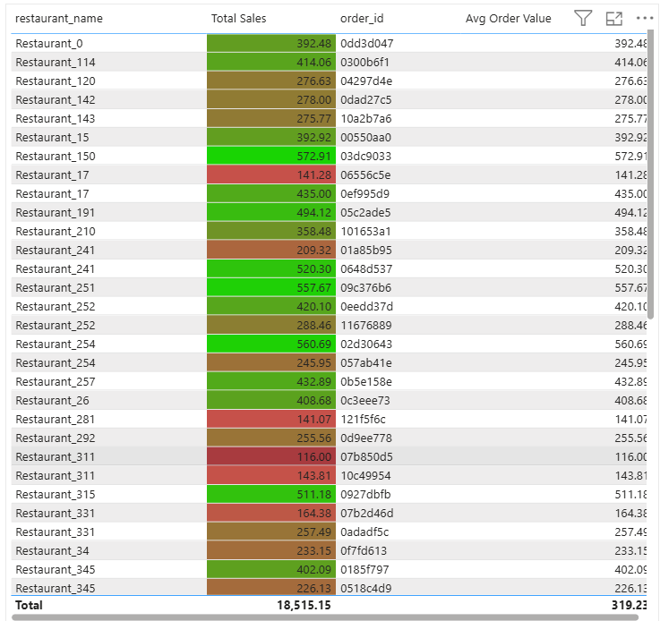
Task 9 – Restaurant Performance Summary (Table)
Insights:
Performance Variance: Restaurant_170 is a top-tier performer with an AOV of ₹1,685, which is significantly higher than the platform average.
Underperformance Identification: Using conditional formatting, Restaurant_425 (₹269) and Restaurant_332 (₹453) are flagged in Red as low-revenue partners.
High-Volume Leaders: Restaurants like Restaurant_363 show high total sales (₹1,612) combined with healthy AOV, indicating consistent customer demand.
Recommendations:
Premium Selection Category: Create a "Gold Membership" or "Premium Selection" for restaurants with AOV > ₹1.5K to attract high-spending customers.
Strategic Support: For restaurants in the Red zone (e.g., Restaurant_425), offer "Budget Combo Bundles" to increase their order volume and visibility on the platform.

Slide 11
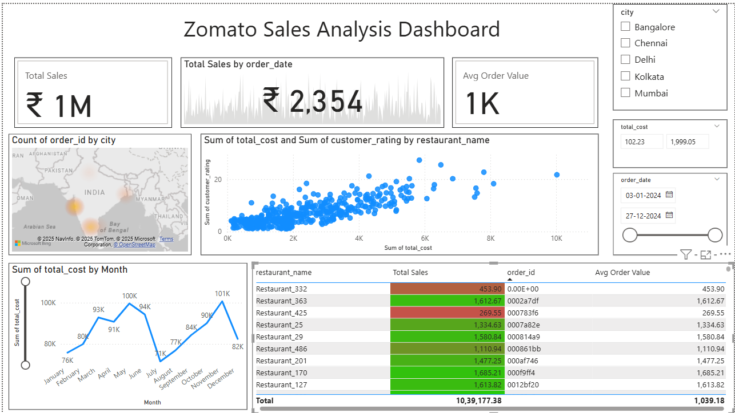
Task 10 – Integrated Business Intelligence Dashboard
Overview:
Holistic View: This dashboard provides a 360-degree view of Zomato’s sales operations by integrating KPIs, regional trends, and restaurant-level data into one page.
Interactivity: The use of Slicers for City, Total Cost, and Date allows stakeholders to filter complex data instantly and find specific answers.
Visual Storytelling: The layout follows a logical flow—starting with high-level totals (₹ 1M Sales), followed by regional distribution (Heat Map), and ending with granular details (Restaurant Table).
Recommendations:
Regional Growth: Based on the Heat Map, Zomato should increase its presence in high-density zones like Bangalore and Mumbai while exploring untapped areas in Delhi.
Performance Monitoring: Managers should use the Conditional Formatting in the summary table to identify "Red Zone" restaurants and offer them operational support to improve their sales.
Seasonal Strategy: Targeted marketing campaigns should be planned for August to recover from the seasonal sales dip identified in the trend analysis.
Data-Driven Decision Making: This dashboard should be used for weekly business reviews to track the Average Order Value (AOV) and ensure it stays above the ₹ 1K threshold.

Slide 12
Thank You

